Slide 1
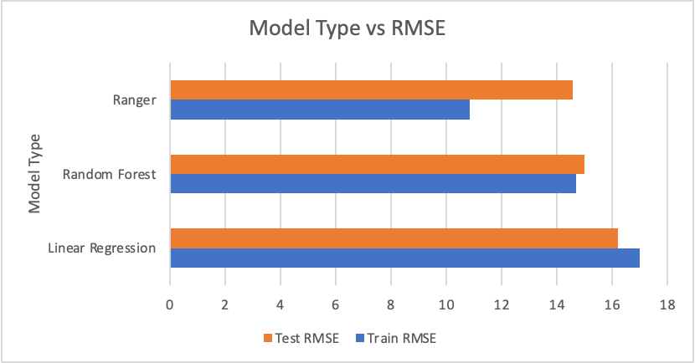
The Perfect Tune – Kaggle Competition
Harrison Dvoor (hd2523)
Private Leaderboard RSME: 14.51275
Public Leaderboard RMSE: 14.65168
Best Model: Ranger
Methods
Variable Selection:
-First tried hand-picking the predictors to include based on my intuition
-Then ran forward selection to determine which of the variables in the original dataset I should use in my model.
-After cleaning the data, I kept the variables from forward selection, then messed around with how many of the top genres to include based on frequency (top 10, 25, 50, 100, 200)
Model Selection:
-Linear Regression
-Random forest
-Ranger
Key Findings/Takeaways:
-Data cleansing/transformation is everything. The rest of the process is pretty repetitive. I should’ve been cleaning my data from the start.
-I should’ve explored more model types instead of trying to enhance the same two kinds (Random Forest/Ranger).
-I didn’t realize until late that I did not utilize performer in my model. Although it would have to be cleaned/transformed, I definitely should have included it in my model.

